Slide 1

TESTE FRONT END
Com Eclipse e Selenium
Tatiane A. Nicchetti

Slide 2
Primeira Parte
Planejamento de testes

Slide 3
CASO DE TESTE: SEARCH BAR
Plano de Teste:
objetivo: verificar o uso da barra de busca no site “https://informatica.sp.senai.br/”
tecnologias: Eclipese, JDK-8, Apache Maven e WebDriver
Fluxo:
usuário abre o site
digita na barra de procura
clica no botão de procurar
aparacem resultados compatíveis com a busca

Slide 4
Segunda Parte
Código

Slide 5
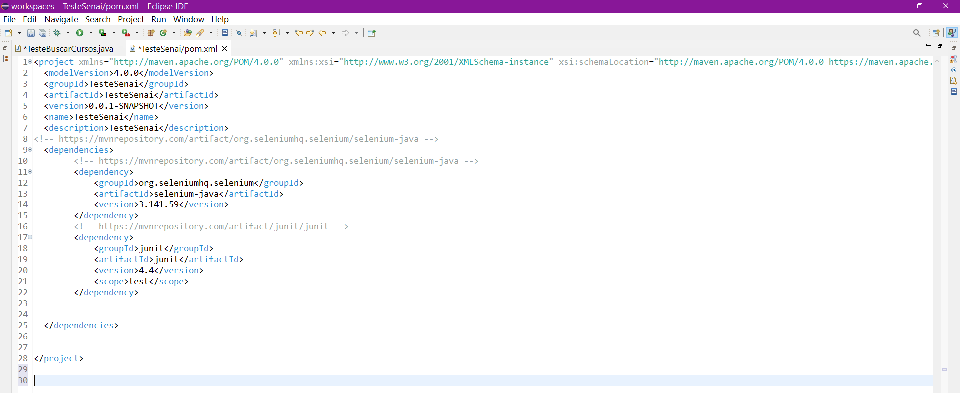
POM.XML
PRINT

Slide 6
POM.XML
CÓDIGO
<project xmlns="http://maven.apache.org/POM/4.0.0" xmlns:xsi="http://www.w3.org/2001/XMLSchema-instance" xsi:schemaLocation="http://maven.apache.org/POM/4.0.0 https://maven.apache.org/xsd/maven-4.0.0.xsd">
<modelVersion>4.0.0</modelVersion>
<groupId>TesteSenai</groupId>
<artifactId>TesteSenai</artifactId>
<version>0.0.1-SNAPSHOT</version>
<name>TesteSenai</name>
<description>TesteSenai</description>
<dependencies>
<!-- https://mvnrepository.com/artifact/org.seleniumhq.selenium/selenium-java -->
<dependency>
<groupId>org.seleniumhq.selenium</groupId>
<artifactId>selenium-java</artifactId>
<version>3.141.59</version>
</dependency>
<!-- https://mvnrepository.com/artifact/junit/junit -->
<dependency>
<groupId>junit</groupId>
<artifactId>junit</artifactId>
<version>4.4</version>
<scope>test</scope>
</dependency>
</dependencies>
</project>

Slide 7
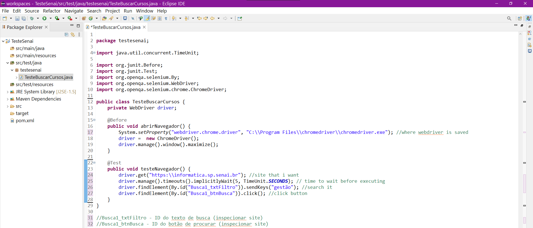
TESTE.JAVA
PRINT
BUSCAR POR“GESTÃO”

Slide 8
TESTE.JAVA
CÓDIGO
BUSCAR POR“GESTÃO”
package testesenai;
import java.util.concurrent.TimeUnit;
import org.junit.Before;
import org.junit.Test;
import org.openqa.selenium.By;
import org.openqa.selenium.WebDriver;
import org.openqa.selenium.chrome.ChromeDriver;
public class TesteBuscarCursos {
private WebDriver driver;
@Before
public void abrirNavegador() {
//where webdriver is saved
System.setProperty("webdriver.chrome.driver", "C:\\Program Files\\chromedriver\\chromedriver.exe");
driver = new ChromeDriver();
driver.manage().window().maximize();
}
@Test
public void testeNavegador() {
driver.get("https:\\informatica.sp.senai.br"); //site that i want
driver.manage().timeouts().implicitlyWait(5, TimeUnit.SECONDS); // time to wait before executing
driver.findElement(By.id("Busca1_txtFiltro")).sendKeys("gestão"); //search it
driver.findElement(By.id("Busca1_btnBusca")).click(); //click button
}
}
//Busca1_txtFiltro - ID do texto de busca (inspecionar site)
//Busca1_btnBusca - ID do botão de procurar (inspecionar site)

Slide 9
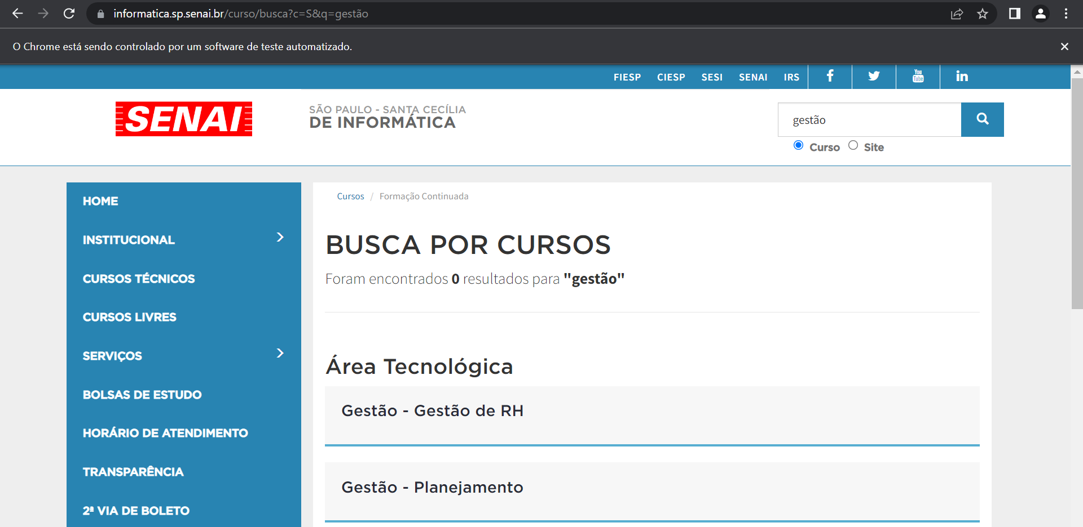
TESTE.JAVA
RESULTADO
BUSCAR POR“GESTÃO”

Slide 10
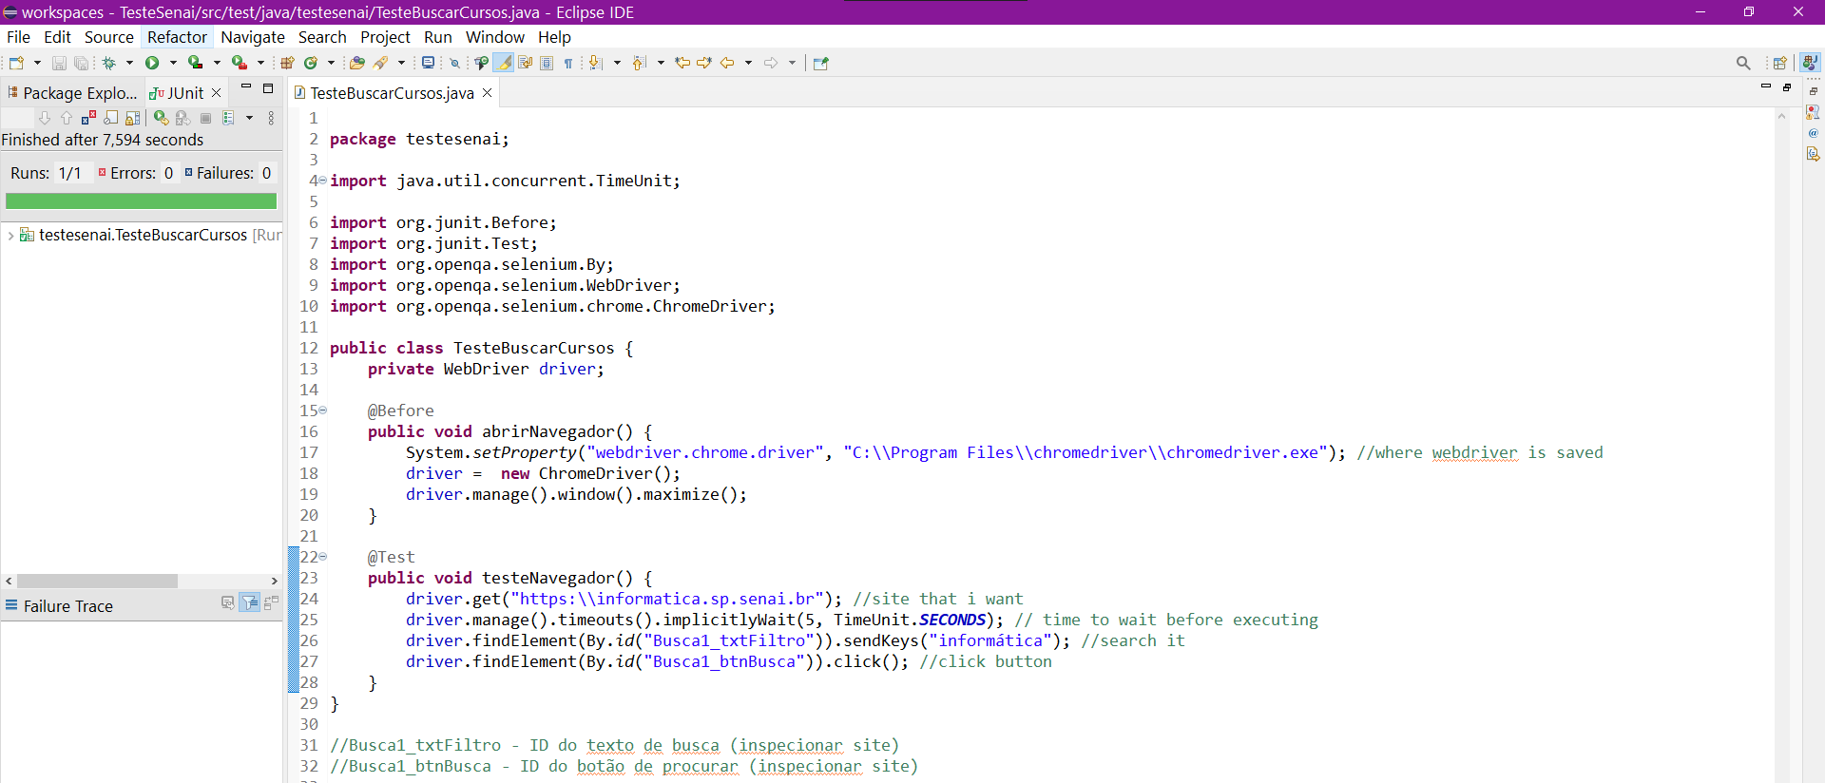
TESTE.JAVA
PRINT
BUSCAR POR“INFORMÁTICA”

Slide 11
TESTE.JAVA
CÓDIGO
BUSCAR POR“INFORMÁTICA”
package testesenai;
import java.util.concurrent.TimeUnit;
import org.junit.Before;
import org.junit.Test;
import org.openqa.selenium.By;
import org.openqa.selenium.WebDriver;
import org.openqa.selenium.chrome.ChromeDriver;
public class TesteBuscarCursos {
private WebDriver driver;
@Before
public void abrirNavegador() {
//where webdriver is saved
System.setProperty("webdriver.chrome.driver", "C:\\Program Files\\chromedriver\\chromedriver.exe");
driver = new ChromeDriver();
driver.manage().window().maximize();
}
@Test
public void testeNavegador() {
driver.get("https:\\informatica.sp.senai.br"); //site that i want
driver.manage().timeouts().implicitlyWait(5, TimeUnit.SECONDS); // time to wait before executing
driver.findElement(By.id("Busca1_txtFiltro")).sendKeys("informática"); //search it
driver.findElement(By.id("Busca1_btnBusca")).click(); //click button
}
}
//Busca1_txtFiltro - ID do texto de busca (inspecionar site)
//Busca1_btnBusca - ID do botão de procurar (inspecionar site)

Slide 12
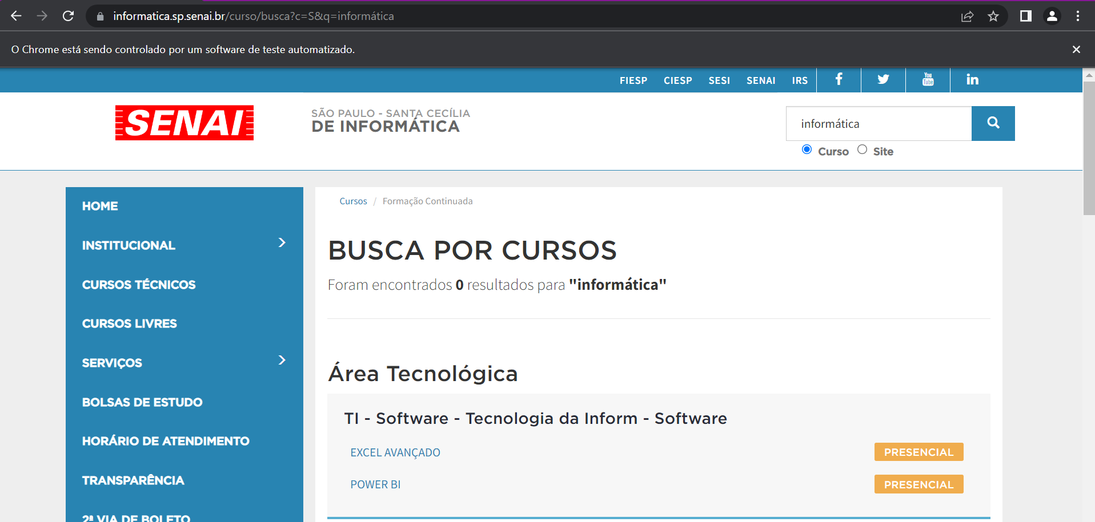
TESTE.JAVA
RESULTADO
BUSCAR POR“INFORMÁTICA”

